Slide 1

Neurological Assessment
Lucy Vermeulen, 2015

Slide 2
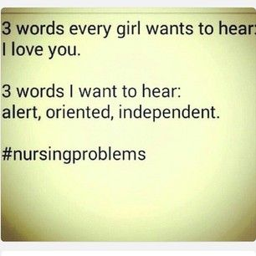

Slide 3
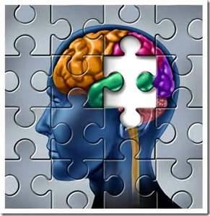
A….B….C….
then, D: Disability
Neurological System

Slide 4
NENA Core Competencies: Neuro
INITIAL NEUROLOGICAL ASSESSMENT, INTERVENTION, and MONITORING
IS A COMPETENCY REQUIRED BY ALL EMERGENCY NURSES
Knowledge of neurological emergencies specific to the
adult/pediatric/geriatric populations
Assessment of level of consciousness
Interpretation of neurological signs and symptoms in
context with history
Assessment of Glasgow Coma Scale
NENA, 2014

Slide 5
Assessment and knowledge of appropriate
interventions for headaches
Assessment and knowledge of appropriate
interventions for seizures
Assessment and knowledge of interventions for
head injury (e.g. increased intracranial pressure, and
administration of hyperosmotics such a Mannitol)
Assessment and knowledge of and interventions for
TIA and stroke (e.g. National Institutes of Health
Stroke Scale, The 8 D’s of Stroke Care)
NENA, 2014

Slide 6
Knowledge of Fibrinolytic protocols
Assessment and knowledge of interventions for spinal cord/vertebral injury
Perform and/or assist with application of cervical collars
Perform and/or assist with spinal stabilization/immobilization
Non-pharmacological pain management therapies
Evaluation of pain utilizing an appropriate pain scale (e.g. numerical 1-10, FACES, FLACC)
Pharmacological management of pain
NENA, 2014

Slide 7
Assessment and knowledge of interventions for organic brain syndrome (dementia and Alzheimer’s disease)
Assessment and knowledge of interventions for acute confusional state (delirium)
NENA 2014

Slide 8
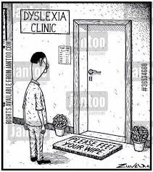
Brief Anatomy Review:
The nervous system coordinates, interprets, and controls interactions between the individual and their environment
The Central Nervous system and
Peripheral Nervous system regulate most
body systems

Slide 9
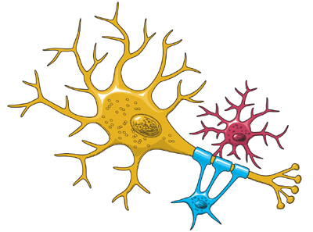
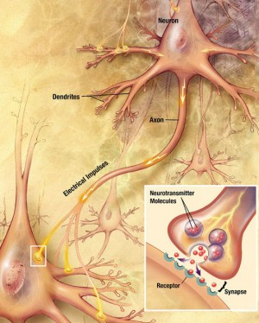
Neuron
basic unit of the nervous system
cannot regenerate
junction between neuron and another cell is
called a synapse
messages are relayed through action
potentials with the help of
neurotransmitters that
alter cell permeability
Notes:
Sensory neurons carry information from the sense organs (such as the eyes and ears) to the brain.
Motor neurons control voluntary muscle activity such as speaking and carry messages from nerve cells in the brain to the muscles.
All the other neurons are called interneurons

Slide 10
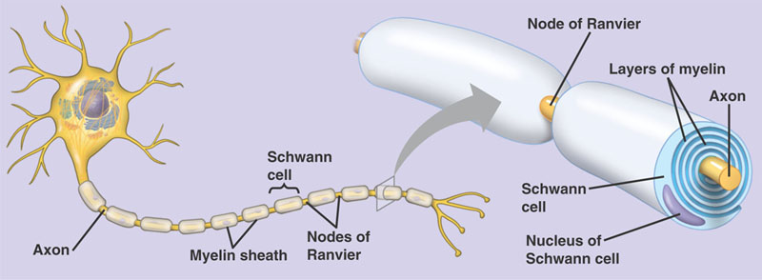
Myelin Sheath
is an insulating layer around nerves that serves to
speed up transmission of impulses along the
nervous system.
damage seen in patients with Guillain-Barre,
multiple sclerosis,

Slide 11
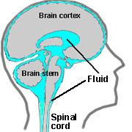
CSF
Within the brain a series of interconnected cavities ventricles produce cerebral spinal fluid (CSF) at a rate 15 to 20 mL/hr.
CSF circulates around the brain in the subarachnoid space and through the central canal of the spinal cord
Functions include shock absorption, glucose transport, metabolic waste removal
Notes:
The CSF is produced mainly by choroid plexus in the lateral, third and fourth ventricles. It flows from the lateral ventricle to the third ventricle through the interventricular foramen (also called the foramen of Monro). The third ventricle and fourth ventricle are connected to each other by the cerebral aquaduct. CSF then flows into the subarachnoid space and the foramen of Magendie. Absorption of the CSF into the bloodstream takes place in the superior sagittal sinus through structures called arachnoid villi. When the CSF pressure is greater than the venous pressure, CSF will flow into the bloodstream. However, the arachnoid villi act as one-way valves: if the CSF pressure is less than the venous pressure, the arachnoid villi will not let blood pass into the ventricular system.

Slide 12
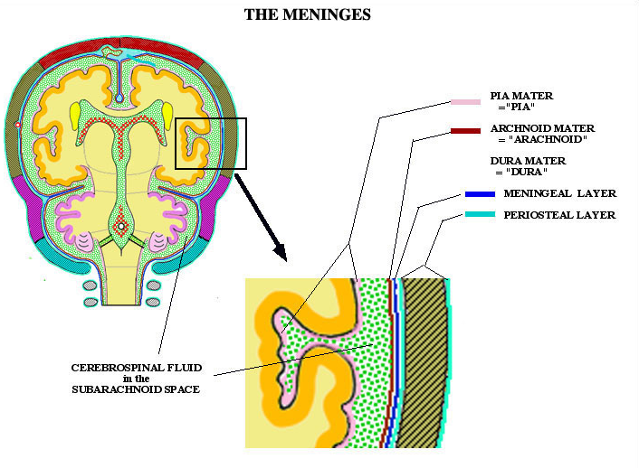
Meninges

Slide 13
Nervous System
Central Nervous System
Brain
Cerebrum
Cerebellum
Brain Stem
Spinal Chord
Peripheral Nervous System
Somatic
Nervous System
Autonomic Nervous System
Sympathetic
Parasympathetic
Notes:
Somatic nervous system
SNS includes all nerves controlling the muscular system and external sensory receptors.
Sensory input from the PNS is processed by the CNS and responses are sent by the PNS from the CNS to the organs of the body.
Motor neurons of the somatic system are distinct from those of the autonomic system. Inhibitory signals, cannot be sent through the motor neurons of the somatic system. The cranial nerves are part of the peripheral nervous system. The somatic nervous system is responsible for movement of voluntary muscles and the process known as a reflex arc. This system carries nerve impulses back and forth between the central nervous system (which is the brain and the spinal cord) and the skeletal muscles, skin, and sensory organs.

Slide 14
Autonomic Nervous System
controls visceral functions
mostly involuntary, but some control: breathing,
swallowing
The ANS affects heart rate, digestion,
respiratory rate, salivation,
perspiration, pupillary dilation
Divided into Sympathetic and Parasympathetic
Nervous system

Slide 15
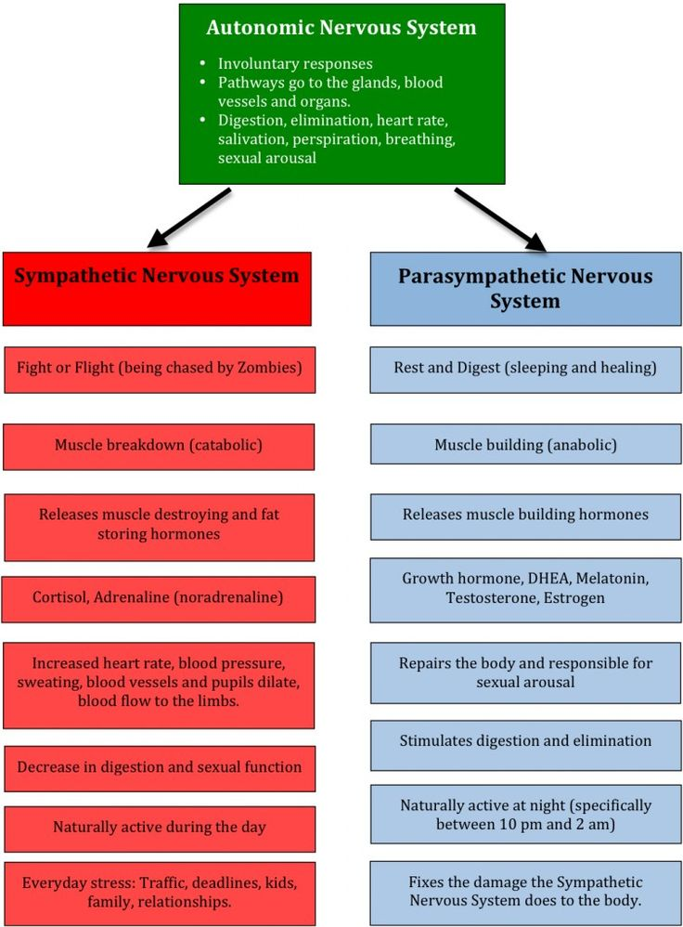

Slide 17
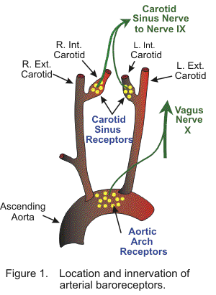
Pressure Receptors
Baroreceptors are innervated by ANS, & located
in carotid sinus (internal carotid artery)
& in aortic arch wall.
When sBp drops below 60 mm Hg,
baroreceptors are no longer
stretched causing vasoconstriction
and rise in BP.
ENA, 2007
Notes:
Baroreceptors are sensors found in the major arteries of the body, including the carotoid arteries and the aorta. When the arterial pressure is increased, the sensors are stretched, signals are transmitted into the central nervous system. Feedback signals are sent back to reduce arterial pressure downward toward the normal level. This is a process of negative feedback. This nervous control of the arterial pressure is by far the most rapid of all our mechanisms for pressure control.

Slide 18
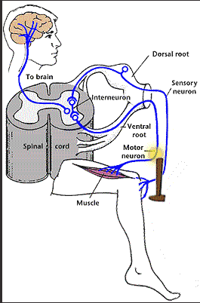
Somatic Nervous System
responsible for carrying motor and sensory information both to and from the central nervous system
responsible for nearly all voluntary
muscle movements as well as for
processing sensory information that
arrives via external stimuli including
hearing, touch and sight

Slide 19
Somatic Nervous System
two major types of neurons: sensory neurons that carry information from the nerves to the central nervous system, and motor neurons (or efferent neurons) that carry information from the brain and spinal cord to muscle fibers throughout the body.
is also associated with involuntary movements known as reflex arcs. (muscles move involuntarily without input from the brain)

Slide 20
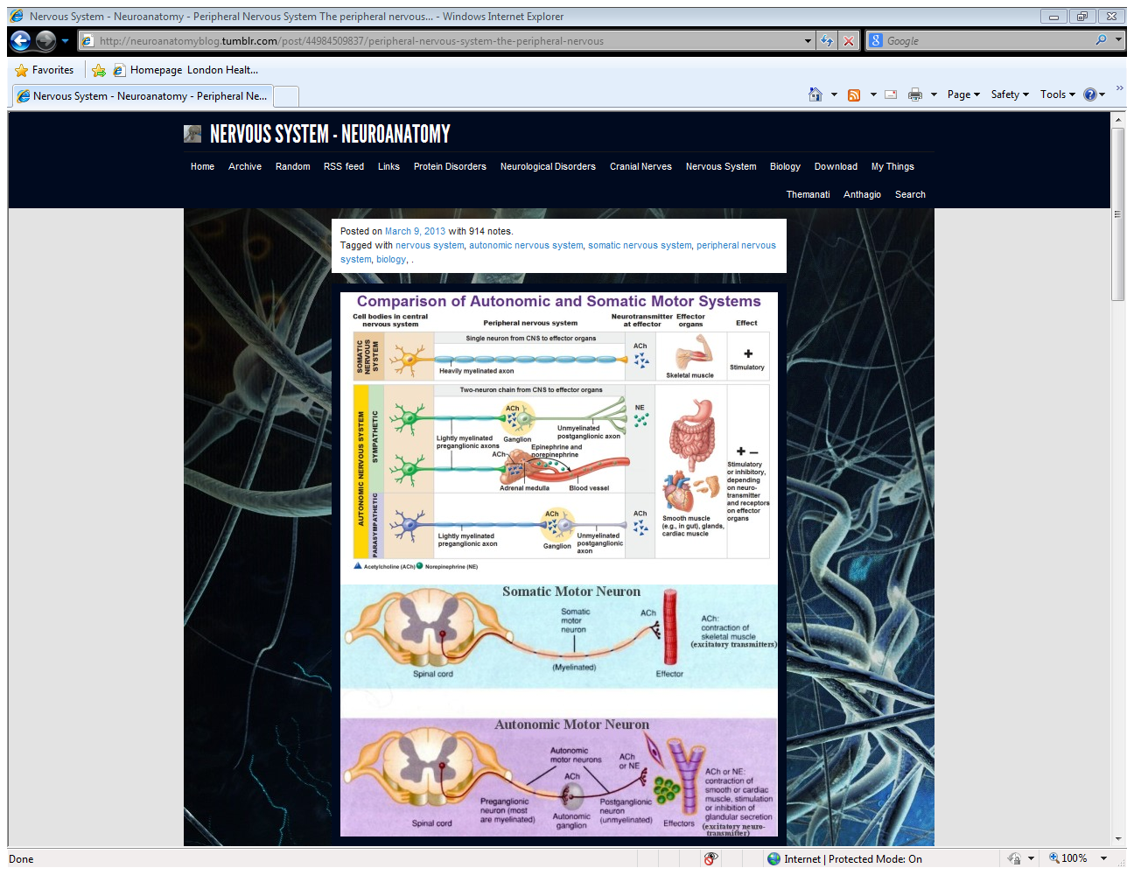

Slide 21
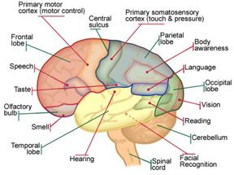
CNS: The Brain
most energy consuming tissue in the body
20% of Cardiac Output
20% oxygen supply
Notes:
-external gray matter and internal white matter
-consists of over 100 billion neurons
-command center
-neurons cannot duplicate or repair themselves.
protected by:
-scalp and subcutaneous tissues
-the bony structures of the skull
-the brain occupies 80% of cranial vault
-10% blood, 10% CSF
-limited compensatory mechanisms

Slide 22
The Lobes
Four distinct areas or lobes
Frontal lobe: movement, reasoning, and planning
Parietal lobe: information processing, senses; pain & touch processing
Temporal lobe: visual memories, language, interpretation
Occipital lobe: vision interpretation, shape recognition

Slide 23
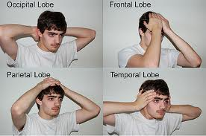
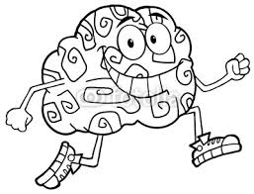


Slide 24
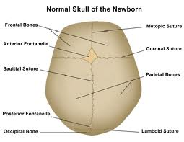
Suture Lines
Sutures: the sutures are not fused
completely until age 8—
this allows room for the brain to
swell if injured, adults don’t
have room for swelling.

Slide 25
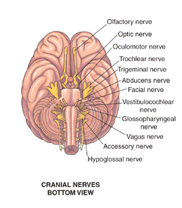
Cranial Nerves
12 pairs of cranial nerves originate in brainstem
may be motor or sensory or both
not consciously controlled therefore used to assess brainstem function
Part of the peripheral nervous system

Slide 26
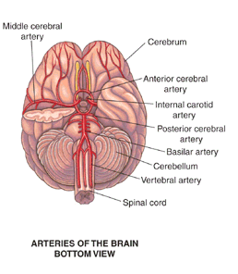
Blood supply
Internal carotids
Supply anterior portion
Vertebral arteries
Supply posterior portion
Anastomosis at the Circle of Willis (collateral circulation)
Notes:
A roughly circular anastomosis that is located at the base of the brain and formed by the anterior communicating artery, the two anterior cerebral, the two internal carotid, the two posterior communicating, and the two posterior cerebral arteries.

Slide 27
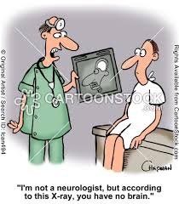
Key Points:
The brain occupies 80% of the cranium
Vascular volume and CSF 20%
Cranial rigidity limits ability to tolerate increases in either

Slide 28
Cerebral Perfusion
the pressure gradient between the systemic
blood pressure and the pressure in the cranium.
The pressure difference is the gradient that
is necessary to "drive" blood from the aorta
into the cranial compartment.
CPP = MAP –ICP
MAP = dBP + 1/3(sBP – dBP)
LHSC, 2001
Notes:
Normally brain autoregulates cerebral blood flow;
with head injuries, this autoregulation is compromised
and brain becomes mores susceptible to BP changes.
The area of the brain that is ischemic from the injury
becomes especially vulnerable to altered blood flow.

Slide 29
CPP & ICP
Mean arterial pressure
ICP
Cerebral Perfusion Pressure
80-90
10
60-80
Healthy Brain: Auto-regulates CPP
Brain-injured: Vulnerable to further ischemic injury
Notes:
Normally brain autoregulates cerebral blood flow; with head injuries, this autoregulation is compromised and brain becomes mores susceptible to BP changes. The area of the brain that is ischemic from the injury becomes especially vulnerable to altered blood flow.
Cerebral autoregulators maintain a constant CBF and works well as long as the systemic mean arterial pressure is between 60-150
CO2 is a primary regulator of blood flow to brain
Increased CO2 (vasodilator) or dec levels of O2 result in cerebral vasodilation and increased blood volume.

Slide 30
Cerebral Perfusion
Adequate cerebral perfusion is critical to avoid neural ischemia. Early hypotension (BP < 90mmHg) is associated with increased morbidity and mortality following severe brain injury.
Monitor GCS & LOC
Look at trends
of patient’s graphics
Watch BP

Slide 31
Intracranial Pressure
Brain
Blood
Volume
Reflection of three volumes.
Normal compensatory
mechanisms allow for dec. CSF
volume, and cerebral
vasoconstriction in
healthy brain.
In injured brain, this
auto-regulation may not work.

Slide 32
The Spinal Cord
elongated mass of nerve tissue
(16 - 18 inches long)
extends from the brainstem (superior border of C1) to the superior border of L2
tapers and terminates into a cone shaped the conus medullaris or “cauda equina”

Slide 33
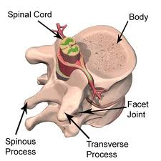
The Spinal Cord
Lies in spinal canal of the vertebral bodies\column
Covered by meningeal layers
the vertebrae and ligament protect the cord from excessive movement

Slide 34
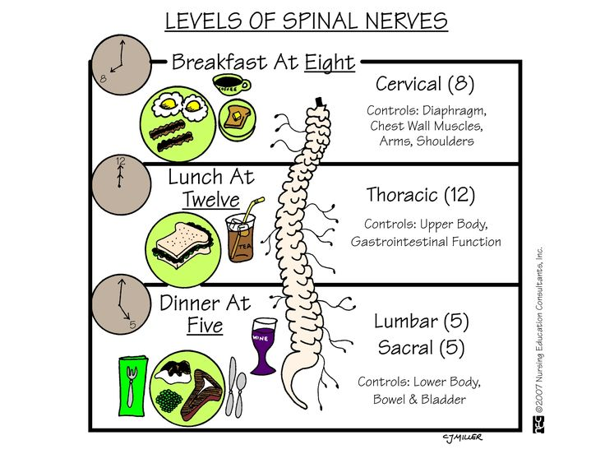

Slide 35
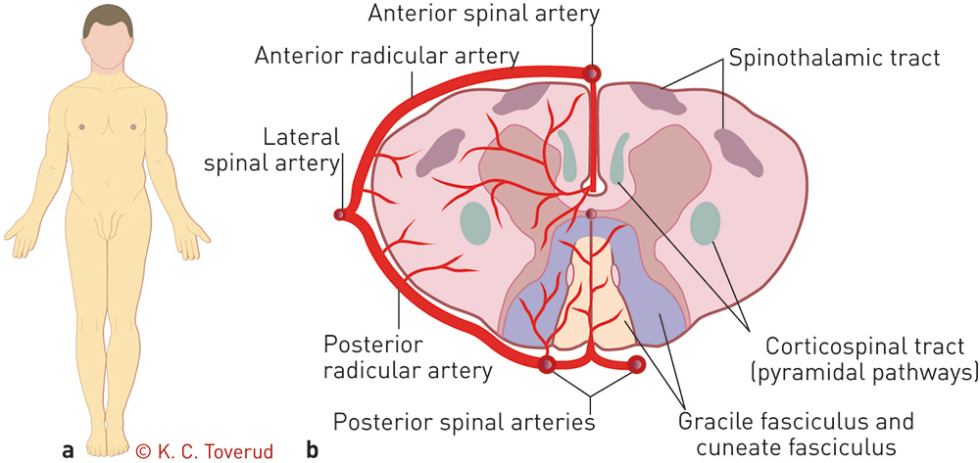
Spinal Cord: Nerve & Vascular Pathways
Notes:
H-shaped core: made up of gray matter, which consists of nerve cell bodies
The gray matter is surround by white matter which forms ascending and descending tracts.
Functions: Descending tracts (pyramidal) – voluntary motor (Located in cerebral cortex)
Ascending tracts (spinothalamic) – pain, temperature, crude touch (Sensory receptors located throughout body)
Posterior tracts (Dorsal) – Proprioception, find touch, 2 point discrimination (Sensory receptors located throughout the body}
Voluntary motor movement impulses originate in frontal lobe of brain. The impulses travel down specific tracts to muscle groups crossing in the medulla. (reason why patients experiences contralateral loss of movement: some exceptions as some fibres descend on same side).

Slide 36
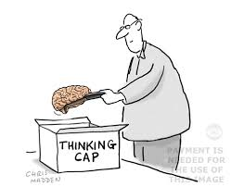
Neurological Assessment & Monitoring in the ED

Slide 37
Neuro Assessment
Most reliable indicator is level of consciousness
Initial assessment and continuous evaluation are required to detect changes

Slide 38
Evaluate LOC:
1. Primary Assessment:
ABC’s then D
AVPU:
A alert
V responds to verbal stimuli
P responds to painful stimuli
U unresponsive
(TNCC)

Slide 39
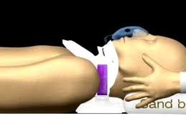
Primary assessment:
C-spine stabilization
Immobilize, and apply collar using at least two people.
If logrolling, need at least 3 people
http://www.youtube.com/watch?v=egVNsQx9Gcs

Slide 40
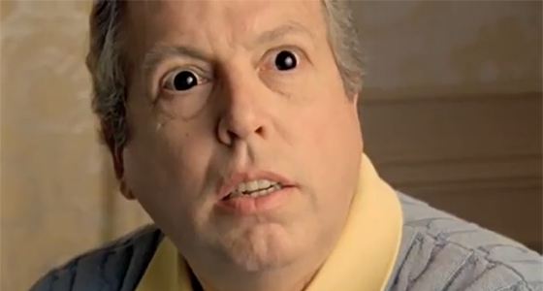
Secondary Neuro Assessment
Pupil check
Equal?
Reactive?
Baseline?

Slide 41
Evaluate LOC:
Secondary Assessment:
Glasgow coma scale:
It is comprised of three parts:
Best Eye response (4-1)
Best verbal response(5-1)
Best Motor response(6-1)
E + V + M = GCS

Slide 42

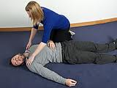
GCS Tips
Always try to
determine
baseline &
document if
different than 15
GCS = 3
The lower
the score the
poorer the prognosis
If GCS < 8, intubate
Airway is no longer being
protected

Slide 43
Complete on all patients
presenting with (potential)
Compromise to neuro status.
Monitor regularly depending
on patient’s status: q4h
on stable neuro patients and
more frequently if unstable
No need to document vital signs
on more than one graphic record
Notes:
Glascow Coma Scale – Eye opening; Best verbal response, best motor response; check pupil size and response

Slide 44
Examples of Presentations Requiring GCS & Full Neuro. Assessment
Headache
Altered vision
Overdose or intoxicated
Syncope
Head injury
Confused
Newly aggressive

Slide 45
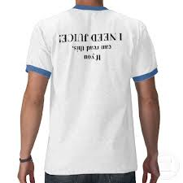
As part of the neurological assessment
and documentation, always ensure patients
have a baseline blood sugar finger pick –
completed and documented
This is indicated for patients with
altered LOC. It must be tied to
the medical directive
“Suspected hypoglycemia” &
documented as such.

Slide 46
GCS ---Paeds
essentially same GCS: (<2)
Best Eye opening
Best verbal response
smiles, listens, follows
irritable cry, consolable
inappropriate persistent cry
agitated restless
no response
Best Motor Response

Slide 47
GCS
When doing a neuro assessment it is important to watch for trends indicating a decreasing LOC
Keep in mind that when patients have ingested alcohol, mind altering drugs, have hypoglycemia or shock the GCS is affected
A coma score of 13 or higher indicates mild brain injury, 9-12 is a moderate injury and 8 or less a severe brain injury

Slide 48
Neuro Assessment
Include family/witnesses in your assessment.
bystanders/family
LOC
drugs /alcohol/meds
baseline

Slide 49
Possible Factors in Altered LOC:
A-E-I-O-U-T-I-P-S
Mnemonic:
A Alcohol
E Encephalopathy, Endocrine, Electrolytes
I Insulin
O Opiates
U Uremia
T Trauma
I Infection
P Psychogenic causes
S Seizure, Syncope

Slide 50
Cerebral Edema
Brain injury
ICP increases
Brain injury
CPP decreases
Secondary Brain injury
Cerebral ischemia; potential hypoxia and further brain injury
Cerebral edema:
can compromise
cerebral perfusion
ENA, 2007

Slide 51
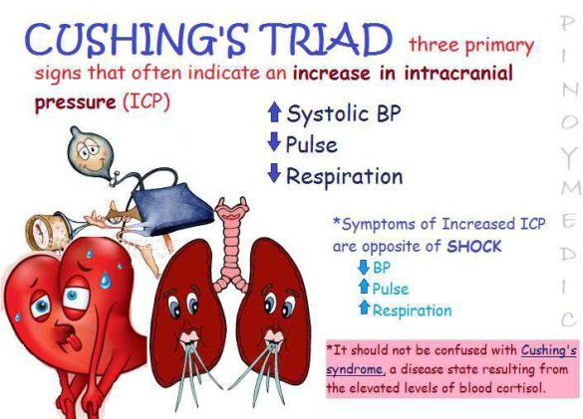
Notes:
Complex reaction involving both the sympathetic (hypertension, vasoconstriction) and later, parasympathetic stimulation (bradycardia)
This ischemia initiates a CNS response known as Cushing’s response
When brain injury occurs, cerebral capillaries can become "leaky"
cerebral blood vessels may dilate in response to brain tissue injury, hypoxemia, hypercarbia, acidosis or hypotension.
If the BP becomes elevated, the increased CPP can lead to increased cerebral blood flow.
When combined with increased capillary permeability or cerebral vasodilation, blood flow can increase to the point where brain edema worsens.
The goal for maintaining the CPP is to ensure that the CPP is high enough to perfuse the brain; while preventing excessive CPP elevations that might worsen any cerebral edema.

Slide 52
Increased Intracranial Pressure
Other late signs
dilated pupil/non-reactive pupil
unresponsive
abnormal posturing
Notes:
dilated pupil/non-reactive pupil
unresponsive
abnormal posturing
change in RR/Rhythm
Cushing’s response: (^SBP, decreased HR, widened pulse pressure, changes in Resp. pattern)

Slide 53
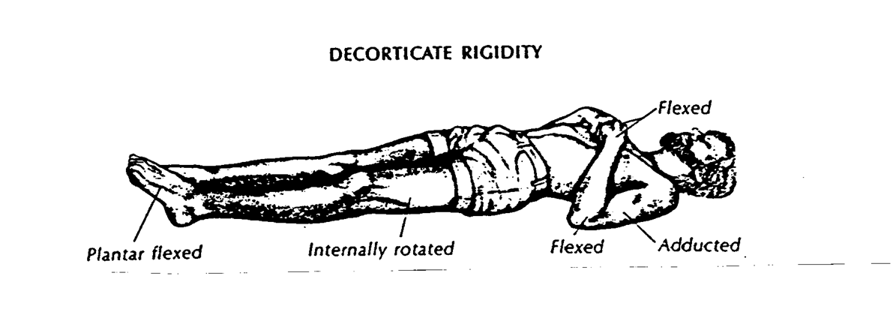
Abnormal Posturing
Decorticate: rigid flexion with arms flexed toward the core and lower limbs extended
lesions above the midbrain
Notes:
Decorticate: rigid flexion with arms flexed toward the core and lower limbs extended
lesions above the midbrain

Slide 54
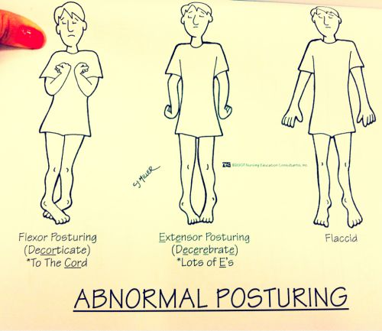
Notes:
Decorticate: rigid flexion with arms flexed toward the core and lower limbs extended
lesions above the midbrain
Decerebrate: rigid extension of arms with wrist flexion and rigid extension of the lower extremities
insult to the brainstem

Slide 55
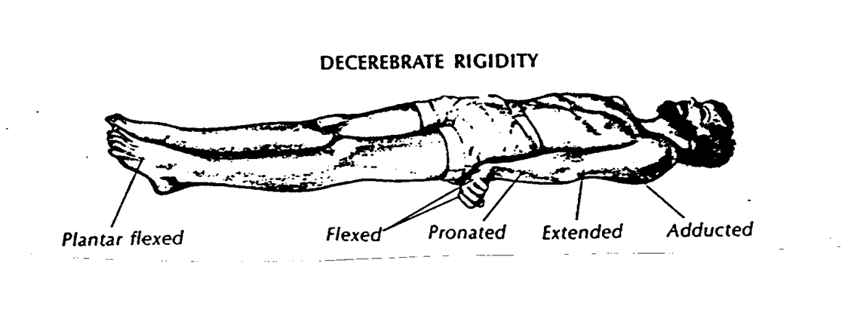
Abnormal Posturing
Decerebrate: rigid extension of arms with wrist flexion and rigid extension of the lower extremities
insult to the brainstem

Slide 56
ED Management of Inc. ICP
Scale: permits
accurate
& safe management
of ICP
Buretrol:
Use this
for accurate
measuring;
Has sampling
outlet
Adjust to
ensure leveled
Line is primed
Laser & bubble leveler
(usually to be leveled at
tragus of ear)
Drainage
Bag
Hole is drilled into skull through dura into lateral ventricle
Notes:
Used in the ED for patients presenting with increased ICP. May do initial measure of pressure, but then used mostly to drain.
Always use clamps appropriately
Measure appropriately with external ear; use laser – includes level
Measure outputs in buretrol hourly – ensuring there is some drainage but not too much
When moving pt about, ensure clamped
Can draw sample from stopcock
Ensure sterile conditions with insertion; appropriate PPE
1:1 nursing is required

Slide 57
Nursing Responsibilities
Accurate Placement: zero level with external aud. meatus
open to collection bag – need order for height
of collection cylinder
open to monitor
NSR assessments q15 min x 2hrs post insertion, then q1h if stable
Report prn/ Document
Evaluate q1h: drain, CSF, patency, patient’s position, dressing, document
Patient care: clamp drain using stopcock closest to patient with any major
repositioning or activity (aggressive chest physio) for a max
of 20 minutes.

Slide 58
Meds. To Dec. Inc. ICP
Mannitol 20% (0.25-1 g/kg): Increases water and
sodium excretion; can cause hypovolemia and
hyperosmotic state
Hypertonic saline 3% (150mL): Works similarly; inc.
Na concentration
Hyperventilation: causes vasoconstriction and lowers ICP,
BUT often worsens ischemia. Usually not recommended.
Notes:
recent studies raise concern that aggressive hyperventilation exacerbates cerebral ischemia
Currently, hyperventilation (PCO₂ of 30-35 mm Hg) is recommended to reduce ICP for only a short period, as a temporizing measure while other methods of ICP control are initiated. Hyperventilation reduces ICP only temporarily, progressively losing effectiveness after 16 hours of continuous use.^{[61]}

Slide 59
Nursing Care
Elevate HOB to 30 degrees
Neuro and vital signs q1h or more often
Steroids if inc. ICP due to mass
May require seizure prophylaxis
Accurate fluid balance

Slide 60
Specific Neurological Emergencies

Slide 61
Seizures
a sudden, abnormal excessive electrical discharge of the brain that can change motor, autonomic function, consciousness or sensation
symptom of underlying problem rather a diagnosis
all of us have a lifetime risk of having a single seizure of approximately 8.8%.

Slide 62
Seizure: assessment
document patient’s behavior, including when the seizure occurred, how fast it started, duration, and the events that happened during and after the episode (whether it involved abnormal muscle movements such as spasms of the head, neck, or facial muscles, tongue biting, or loss of bladder control)

Slide 63
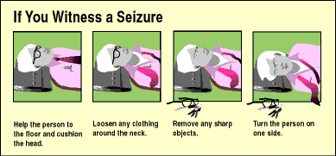
Seizures
ABC’s
prevent / protection from injury
oxygen, IV, glucose
meds
ativan, diazepam,midazolam
phenytoin, phenobarb

Slide 64
Febrile Seizures
Common presentation in children < 5
Treat fever
For children under 1 yr., an LP may be indicated
to rule out an infectious cause
Anticonvulsant therapy not necessarily
indicated

Slide 65
Stroke: CVA
Decreased cerebral blood flow or cerebral perfusion pressure deprives the brain of oxygen and glucose
the third leading cause of death
can strike anybody, at any age
two main types of stroke
ischemic
hemorrhagic

Slide 66
Ischemic Strokes
caused by the blockage / occlusion of cerebral vessels by thrombus or embolus
Accounts for 80-85% of all strokes
the brain tissue beyond the blockage dies from the lack of supply of nutrients, oxygen and glucose.
Notes:
Most common artery affected: middle cerebral artery, involving blood to the lateral surface of the frontal, temporal and parietal lobes

Slide 67
Stroke Protocol
Ischemic Stroke Medical Directive Learning Package
All EMS patients who have developed symptoms
within 4.5 hours
Will require immediate CT to determine whether
hemorrhagic or ischemic
Continuous monitoring
Lab work and IV access; ECG
Potential clot-buster: tPA (weight-based)
To initiate stroke protocol, call 55555

Slide 68
Hemorrhagic Stroke
15-20 percent of strokes are the result of ruptured blood vessels that bleed into the brain and are called hemorrhagic strokes
ruptured aneurysm, dissections, leaking AV malformations, subarachnoid hemorrhage

Slide 69
Transient Ischemic Attack TIAs
Temporary disturbance of blood supply causes transient neurologic deficit
Symptoms present less than 24 hours
No permanent neurological deficit
Follow up in TIA clinic
Likely start on an antiplatelet agent
Are at increased risk for CVA if had TIA within 90 days

Slide 70
Meningitis
an inflammation of the meningeal lining of the brain and spinal cord.
two main types of meningitis:
viral meningitis
bacterial meningitis
others
fungal ( immunocompromised)
noninfectious (drugs, toxic exposure, neoplasms)

Slide 71
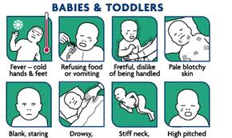
Bacterial meningitis
Is an extremely serious bacterial infection, may take one or two days for s\s to develop or it can take a matter of hours
The potential to cause long term complications, such as deafness or brain injury.
Can cause death
Requires immediate treatment
Notes:
Use appropriate PPE: droplet/contact
Antibiotics often ordered: Vanco, Ceftriaxone, maybe also Ampicillin
Bacterial Meningitis Glucose (mg/dL): Normal to marked decrease. <40 mg/dL. Protein (mg/dL) (Marked increase) > 250 mg/dL. WBCs (cells/µL) >500 (usually > 1000). Early: May be < 100. Cell differential: Predominance of Neutrophils (PMNs) Culture: Positive Opening Pressure Elevated
Viral Meningitis Glucose (mg/dL): Normal (> 40 mg/dL.) Protein (mg/dL) <100 mg/dL (moderate increase) WBCs (cells/µL) < 100 cells/µL. Cell differential: Early: neutrophils. Late: lymphocytes. Culture: Negative Opening Pressure Usually normal

Slide 72
Signs and Symptoms
(severe) headache
fever / high temperature/ chills
vomiting
be sensitive to bright lights /photophobia
neck stiffness (nuchal rigidity)
joint pains
lethargy, drowsy, confused or be in a coma
seizures
Meningical rash of tiny, red-purple spots or bruises that may occur anywhere on the body.

Slide 73
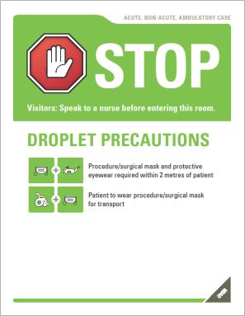
Treatment
ABC’s
Diagnosis is confirmed by LP and cultures
A CT may be ordered prior to LP--potential for herniation if abscess is present
Antibiotics, antipyretics, anticonvulsants
Close Monitoring/Documentation: NSRs, VS
Ensure precautions

Slide 74
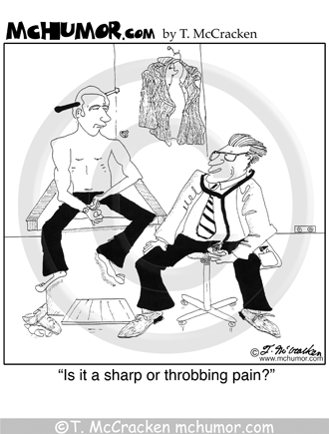
Headaches
one of the most common complaints
symptom of underlying disorder
life threatening to minor
When would it be life threatening?

Slide 75
Assessment
Worst headache? When did it start?
Related to injury or trauma?
Localized or Generalized?
Personality changes or memory loss?
Signs of infection ?
Visual changes?
Seizures?
Coexisting medical Conditions?
Medications? \ Treatments?

Slide 76
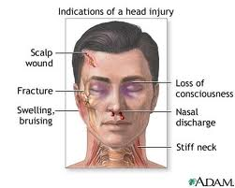
Head Injuries: S & S
Notes:
Scalp lacerations:
extensive vascular supply, poor constrictive properties
bleed profusely
direct pressure

Slide 77
Scalp Lacerations
extensive vascular supply, poor constrictive properties
bleed profusely
direct pressure

Slide 78
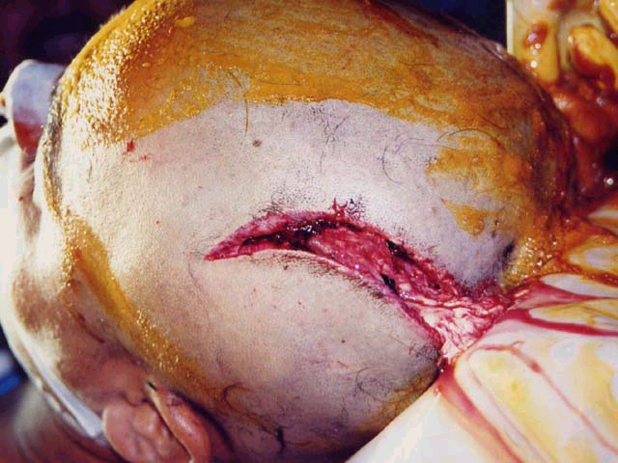
Open brain injury

Slide 79
Closed Head Injury
Concussion
mildest form of brain trauma
no structural damage,
temporary disruption of neuro function
Contusion
bruise on the brain’s surface
mildest form of focal brain injury
micro hemorrhage, focal areas of trauma
temporal, frontal areas usually affected

Slide 80
Bleeds
https://www.pinterest.com/pin/86835099039118052/?od=aA5jmvrX%2FDac9%2FITkTdVR%2B3bcrnr8f46ZTJeKBU%2BWCCYgXCl0B%2FIfib9xWIgo7gmVvqN%2Bd03rJ8Q%0A83dKfVqbfiOUmk9fq2T36%2B23rygzHOI9Zb4bDeSHB3WuXs58ctatAlce2HLrg9oSjtVyj%2FbwIOoD%0Ap%2F5FOzyrWgjNlRjsGxuUruBvVq4MvG%2BXdZJMgt7LMyfn82EI9nUAds0dx0oS7A%3D%3D%0A&user_id=THVjaWEuVmVybWV1bGVuQGxoc2Mub24uY2E%3D%0A&conversation=4756620992835491680&invite_code=0fbb7cd55e36ee3c4f077bb2cb50289f&utm_campaign=msgpin&e_t=bbf65c57b4ad43349990e270e0b42a45&utm_content=86835099039118052&utm_source=31&e_t_s=cta&utm_medium=2000

Slide 81
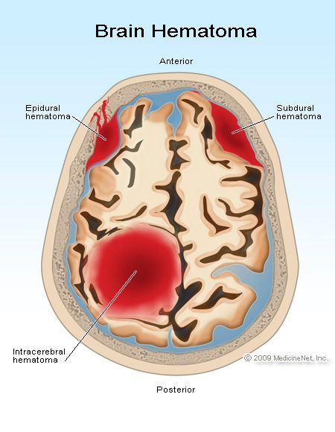
Epidural Hematomas
collection of blood between the skull and dura matter
high mortality
direct blow
Hallmark sign: unconsciousness
followed brief lucid period,
then another loss of
consciousness **
Notes:
often occur # temporal bone with a tear in the middle meningeal artery or vein under the bone
“Most cases of EDH are due to head trauma caused by traffic accidents, falls, and assaults. Skull fractures are present in 75 to 95 percent of patients.
EDH in adults is most commonly (approximately 85 percent of cases) due to arterial injury
Unchecked hematoma expansion leads to elevated intracranial pressure and clinical signs, such as an ipsilateral dilated pupil (due to uncal herniation with compression of the oculomotor nerve), or the Cushing reflex (ie, hypertension, bradycardia, and respiratory depression/irregularity). Such events will culminate in brain herniation and death unless immediate decompression is undertaken”
.
(Retrieved Jan 16, 2013 from http://www.uptodate.com/contents/intracranial-epidural-hematoma-in-adults?source=search_result&search=epidural+bleed&selectedTitle=1%7E150)

Slide 82
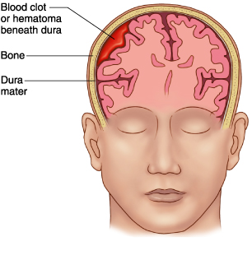
Subdural Hematomas
a focal brain injury between the dura mater & arachnoid membranes
most frequent and has the highest mortality
usually as a result of rupture of the
bridging veins in the subdural space
Notes:
Age and neurologic status as assessed with the Glasgow coma scale (GCS) are important prognostic indicators in patients with SDH, as illustrated by the following reports
The decision between operative or nonoperative management of SDH is based upon multiple factors, including the following [2]:
Glasgow coma scale (GCS) score (table 1)
Head CT findings, mainly SDH clot thickness, degree of midline shift, and presence of associated brain lesion
Neurologic examination, including pupillary signs
Clinical stability or deterioration over time
Acuity of SDH
Presence and severity of comorbidities and associated trauma
Age
Nonoperative management of acute SDH may be appropriate for clinically stable patients with small hematomas (ie, clot thickness <10 mm), even those with coma, as long as there are no clinical or CT signs of brain herniation (ie, midline shift <5 mm) or elevated intracranial pressure [2].
SDH occurs most frequently in infants and toddlers less than two years of age. Approx 8% occur in difficult vag deliveries – forceps, vacuum

Slide 83
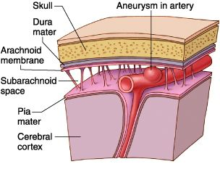
Subarachnoid Hemorrhage
Bleeding between arachnoid space and pia mater
Can be caused by AV malformation, aneurysm, MVCs
Factors: HTN, smoking, aneurysm
Symptoms: sudden onset headache,
often in occiput, altered LOC, N/V,
Treatment: manage ICP, surgery,
coiling, HOB
raised, dec. stimulation,

Slide 84
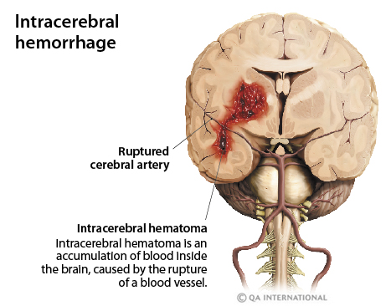
Intracerebral Hemorrhage
Notes:
The main cause of intracerebral hemorrhage is arterial hypertension, which weakens the blood vessels

Slide 85
Diffuse Axonal Injury
usually from blunt trauma causing shearing and disruption of neuronal structures
early CT scans may be unremarkable
serial exams reveal areas of edema and microvascular hemorrhage
extensive lesions in white matter
(Marx, Hockberger & Walls, 2006)
Notes:
DAI is one of the most devastating types of Traumatic Brain injuries
Traditionally: DAI is “described as coma beginning immediately at the time of trauma and persisting for at least 6 hrs. However, some patients with DAI may recover briefly before lapsing into prolonged coma. Most common CT finding after sever head trauma, in approx 50% of all comatose head-injured patients. No specific lesions seen on CTs
Traumatic brain injury occurs when sudden trauma injures the brain. (Can be focal or diffuse)
Concussion is the most common type of TBI. Technically, a concussion is a short loss of consciousness in response to a head injury, but in common language the term has come to mean any minor injury to the head or brain. Typically, there are no long term after effects on overall brain function from such injuries.
More severe forms of TBI occur in situations where the human head undergoes sudden changes in velocity, resulting in Diffuse Axonal Injury (DAI). Motor vehicle accidents (MVAs) are a frequent example of such situations. Severe TBI seen in MVAs arise as a result of acceleration-deceleration events of the brain within the skull, without skull fracture (so-called "closed head" trauma). This event usually occurs as vehicle occupants are thrown forward or sideways, resulting in collisions between the head and windshields, dashboards, etc. Brain injury in closed-head trauma may result from direct trauma to the peripheral margins of the cerebral hemispheres as they impact the skull, but the majority of severe brain injuries in acceleration-deceleration events result from DAI. While many such injuries involve physical impact of the head with some portion of the vehicle, it is the sudden acceleration-deceleration of the head, apart from impact, that results in DAI

Slide 86
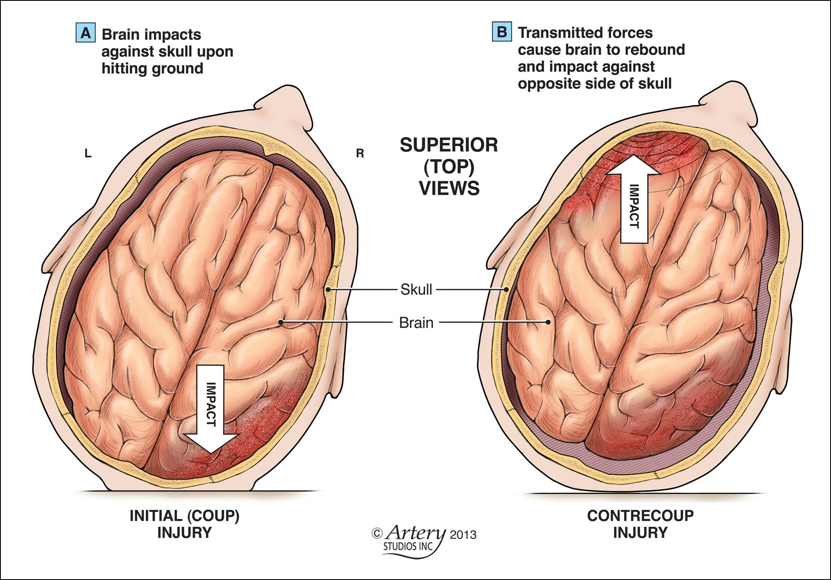
McLeish, 2012
Notes:
Coup contrecoup injury

Slide 87
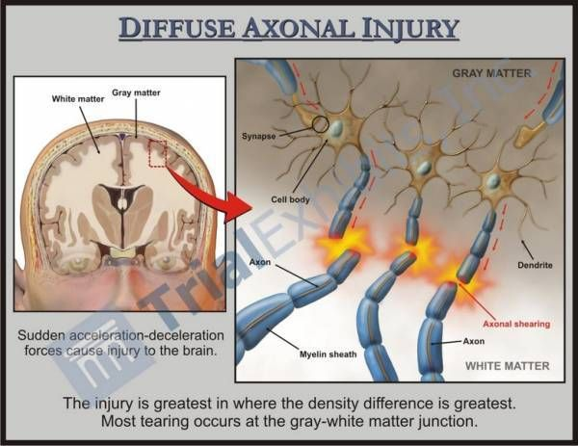

Slide 88
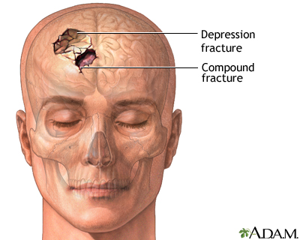
Skull Fractures
signs and symptoms:
headache, N/V
drainage from ears nose
CSF leak-- infection risk
subconjunctival hemorrhage
agitation
altered LOC (possible)

Slide 89
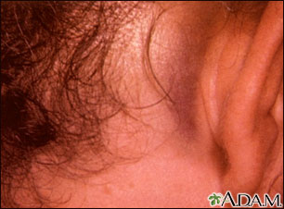
Battle’s Sign
Seen with
Basilar skull fracture
Notes:
Skull fractures are common in children and result from accidents (the majority are automobile or auto/bike accidents) or abuse. Battle's sign is seen several days following a basilar skull fracture. There may have been bloody drainage from the ear immediately after the fracture occurred.

Slide 90
Remember:
Not the nurse’s job to diagnose, but assess,
monitor and document
Neuro signs, Vital signs, Fingerpick,
Level of consciousness
Look at trends
Know your patient’s baseline
Regular pupil check

Slide 91
Spinal Cord Injury
Primary:
direct blow, blunt or penetrating forces
Secondary:
as a consequence of vascular changes
derangement of gray and white matter, which decreases oxygen tension and disrupts vasomotor tone and auto-regulation
complete or incomplete

Slide 92
Spinal Cord Injury
S/S related to location of injury
C spine injury: pulm. and resp. problems
T1 -4: loss of sympathetic tone
low thoracic: loss of abd. muscle function, gastric distention, loss of resp. reserves
lumbosacral: loss of temp. regulation, bowel and bladder function

Slide 93
Spinal Cord Injury
Neurogenic Shock
Spinal Shock
usually with injury above T6
temp. sympathetic disruption cause flaccid paralysis, loss of sphincter tone, bradycardia and hypotension (blood volume is normal)
cool, dry skin, bounding peripheral pulses
no sweating below injury level
temporary loss of all reflexes, flaccid paralysis, and areflexia
intensity and duration are determined by the level of injury
Usually resolves in 24 hours
Notes:
The higher the level of injury the more likely it is for the patient to exhibit severe symptoms. only after other injuries have been identified and treated can the diagnosis of neurogenic shock (as opposed to hypovolemic shock) safely be made.
Give inotropes, maybe steroids
Autonomic dysreflexia, can occur at any time after spinal shock has subsided.
-cluster of symptoms that results in an exaggerated sympathetic response to noxious stimuli.
-can lead to stroke or death if not managed.
-the patient may develop severe headache, blurred vision, SOB, nausea, pallor, bradycardia, sweating.
-(usually caused by bladder distension, UTI’s, kidney stones, tight fitting clothes, fecal impaction, etc.)
Tx-raise HOB, monitor BP, nifedipine, hydralazine, remove the cause.

Slide 94
SCIWORA
Spinal Cord Injury without Radiological Abnormality
More common in children because neck ligaments are more laxity (forgiving)
Most common at cervical level
Child will have neurological deficits but no radiologic evidence
Associated with Hyperextension, hyperflexion,
distraction, spinal cord infarction
Caviness, 2013
Notes:
it is important to remember that patients with blunt trauma who have a history of transient neurologic symptoms that have resolved by the time of initial evaluation may have a significant injury to the spinal cord and/or spinal column despite a normal physical examination and normal spine radiographs and/or CT.
Spinal cord infarction: vertebral artery occlusion
Distraction: Longitudinal - stretched well beyond the tolerance of the spinal cord without subsequent radiographic bony damage
(neonates post breech extraction birth; kids wearing only lap belts being thrown forward)

Slide 95
Cauda Equina Syndrome
results from mechanical compression of any of the cauda equina nerve roots
Causes: Herniated lumbar discs, spinal stenosis, presence of bony fragments, tumors, hematoma
these nerve roots control voluntary and involuntary actions of the bowel, bladder, and sexual function

Slide 96
Cauda Equina Syndrome
S/S:
symptoms can present suddenly or progress over time
motor and sensory abnormalities depending on level and severity of compression
back pain
bowel/bladder incontinence or retention

Slide 97
Cauda Equina Syndrome
Treatment
steroids, treat acute symptoms
prompt correction of compression with surgery i.e. surgical laminectomy and discectomy
urgent decompression is critical for full recovery

Slide 98
Assessing & Monitoring
Spinal Cord testing sheets
Neuro checks
Complete as ordered or q4h on stable patients
More frequently on unstable patients: q15-60 minutes
Look for trends
Know your patient’s baseline
You could be surprised what you discover!

Slide 99
Initial Documentation: Required for all patients
Full A, B, C assessment
Neuro vitals and full assessment on all patients whose presenting complaint is neuro-related
Fingerpick if altered LOC (as per medical directive)

Slide 100
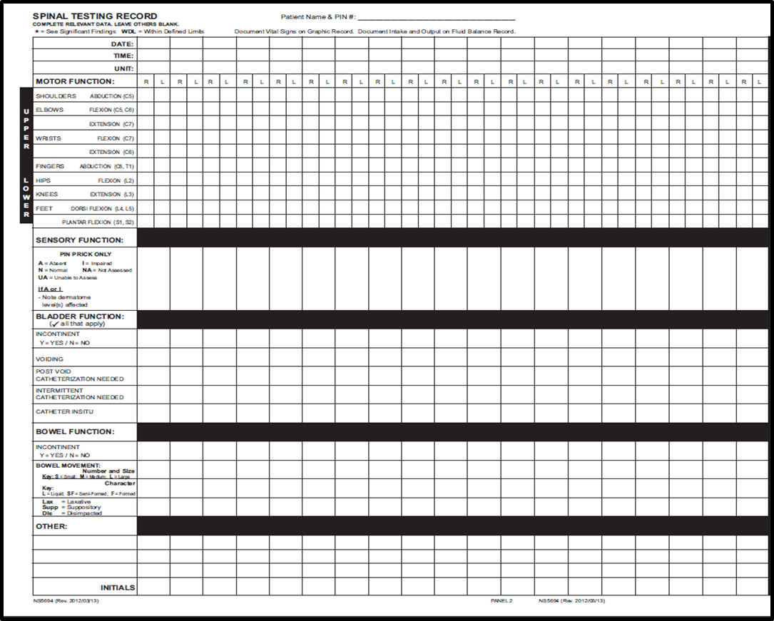
Scales: SCT
Motor function
Sensation
Bladder function
Bowel function

Slide 101
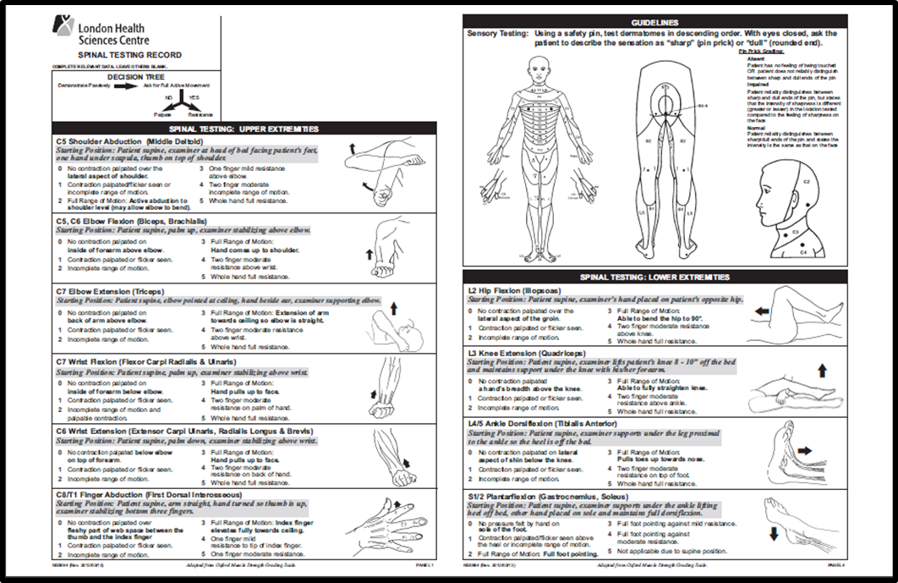
Spinal Cord Testing

Slide 102
Reassessments: Neurological
Full head-to-toe assessment at least q shift
Check stable patients at least q1h
Reassess stable patients: vitals, GCS, SCT at least
q4h & document
All patients with IVs, foleys, alteration if fluid status
must have fluid balance documentation completed
minimally q-shift.
You must know your patients, and
communicate & document accordingly.

Slide 103



Slide 104
References
Calgary Emergency Medicine (2003) Pediatric Neurologic Emergencies. Retrieved Jan 16,
2013 from calgaryem.com/files/pediatricneurologyemergencies2003.ppt
Caviness, A. (2013). Spinal cord injury without radiographic abnormality in children. UpToDate.
Retrieved Nov. 27, 2013 from http://www.uptodate.com/contents/spinal-cord-injury-without-
radiographic-abnormality-sciwora-in-children
Emergency Nurses Association (2007). Trauma Nursing Core Course, Provider Manual, 6th ed.
Illinois: Des Plaines
LHSC (n.d.). Neurological Assessment Tools. Retrieved Jan 16, 2013
from http://www.lhsc.on.ca/Health_Professionals/CCTC/standards/bedside_sheets_CCTC_July_20
LHSC (2001) EDUBRIEFS in CCTC Cerebral Perfusion Pressure (CPP). Retrieved Jan. 16, 2015 from
http://www.lhsc.on.ca/Health_Professionals/CCTC/edubriefs/cpp.htm
McBride, W. (2011) Intracranial Epidural Hematoma in Adults. UpToDate. Retrieved April 29, 2013 from
http://www.uptodate.com/contents/intracranial-epidural-hematoma-in-
adults?source=search_result&search=epidural+bleed&selectedTitle=1%7E150)
McCaffrey, P. (2008). The Meninges and Cerebrospinal Fluid. Retrieved April 29, 2013 from
http://www.csuchico.edu/~pmccaffrey/syllabi/CMSD%20320/362unit3.html

Slide 105
References
McLeish, J. (2012). Brain Injury Series Part 2: The Ways a Brain Can Be Injured. Retrieved May 14, 2015
from http://blog.mcleishorlando.com/blog/brain-injury-series-part-2-the-ways-a-brain-can-be-
injured/#more-1092
National Emergency Nurses Association (2014). Emergency Nursing
Core Competencies. Retrieved May 7, 2015, from
http://nena.ca/w/wp-content/uploads/2014/11/NENA-Core-Competencies.pdf
Neurotrauma (2000). Cerebral Perfusion Pressure. Retrieved April 30, 2013 from
http://www.trauma.org/archive/neuro/cpp.html

